Slide 1

COURCE PROJECT
REAL TIME OPERATING SYSTEM
TEAM 13
TEAM DETAILS
SL.NO | NAME | USN
01 | SHIVANANDA BIRADARA | 01FE21BEC272
02 | RACHANNA ULLAGADDI | 01FE21BEC273
03 | SONAL | 01FE21BEC274
04 | ADITYA WALI | 01FE21BEC306

Slide 2
Display In order to ensure passengers comfortability in the car implement a temperature control mechanism.
Algorithm
Initialize the peripherals. Initialize the semaphore and interrupt.
Initialize the execution of the task by task 1;
Read the adc value and display it on the lcd and uart.
Check the temperature condition and set the events accordingly
and release the semaphore to perform the other tasks
When an external interrupt will occur then turn off the ac and save the
charge of the battery .

Slide 3
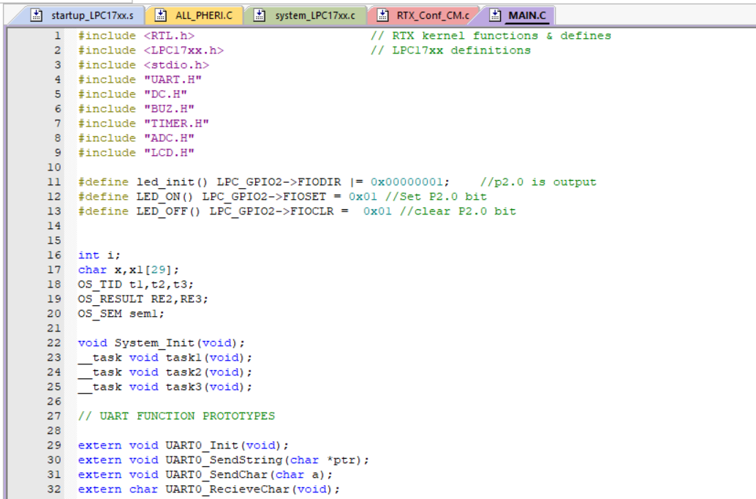

Slide 4
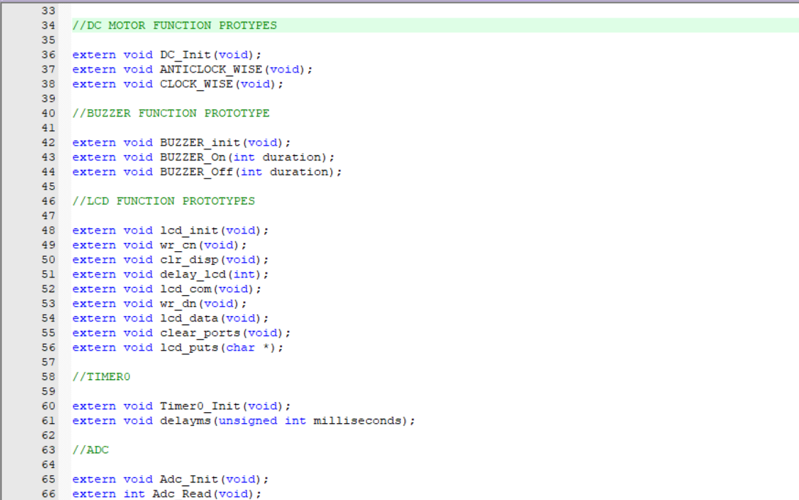

Slide 5
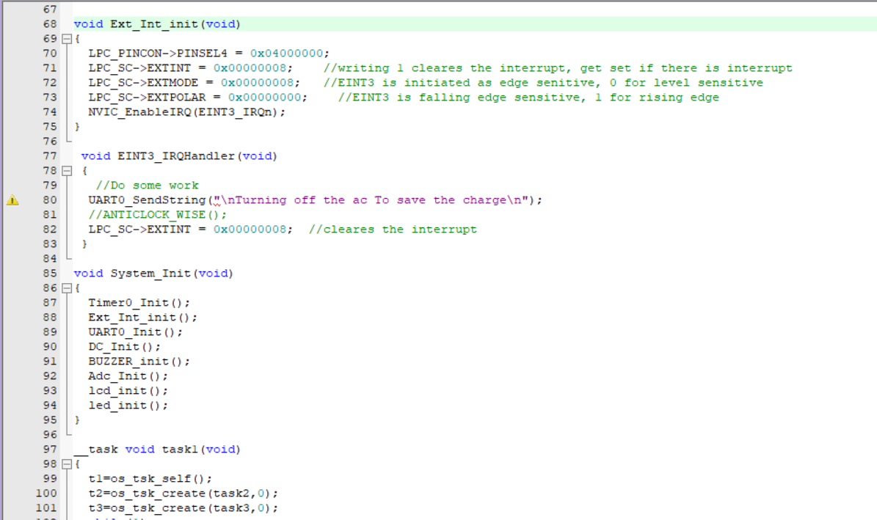

Slide 6
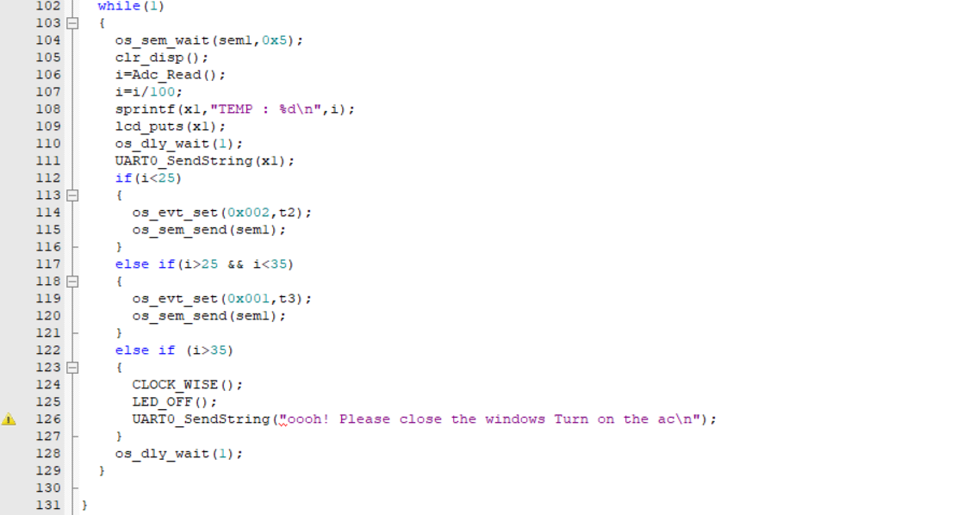

Slide 7
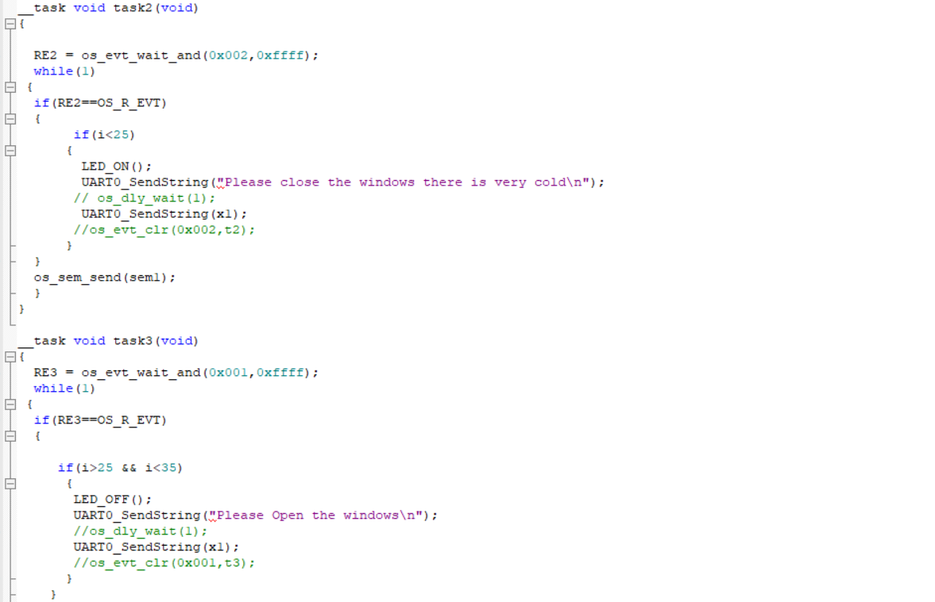

Slide 8
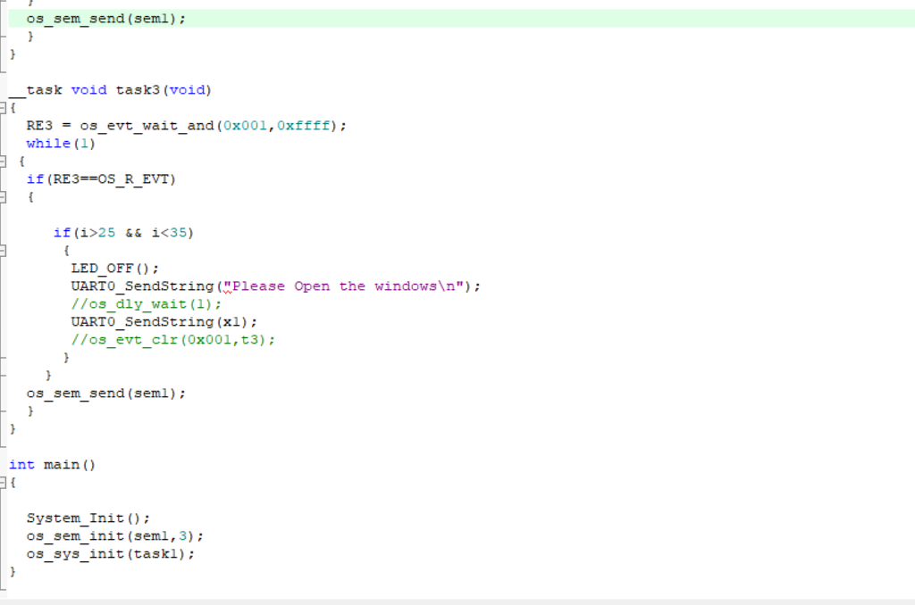

Slide 9
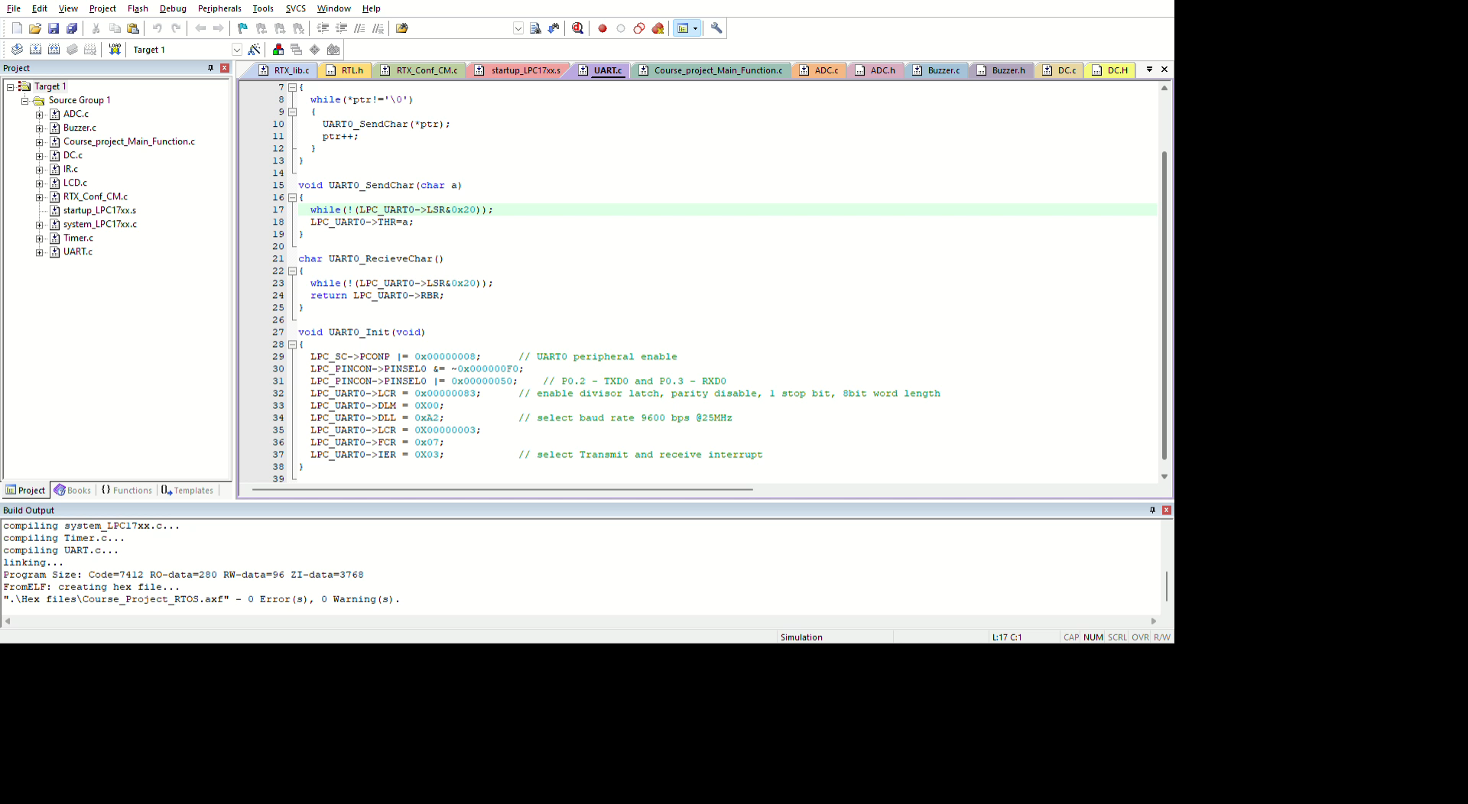
SOFTWARE IMPLEMENTATION :

Slide 10
Thank You

